Slide 1
CH 02: Basic Structures
Sets, Functions, Sequences, Sums, and Matrices

Slide 2
Content
CH 02
Sets
Set Operations
Functions
Sequences and Summations
Cardinality of Sets
Matrices

Slide 3

Functions
Definition 1: Let $A$ and $B$ be nonempty sets. A function $f$ from $A$ to $B$ is an assignment of exactly one element of $B$ to each element of $A$.
We write $f (a) = b$if $b$ is the unique element of $B$ assigned by the function $f$ to the element $a$ of $A$.
$f : A → B$.
Functions are sometimes also called mappings or transformations.

Slide 4
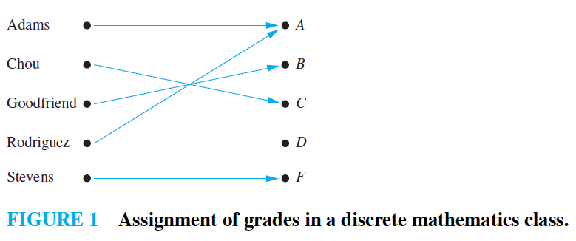
Functions

Slide 5
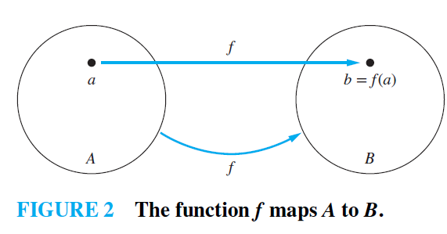

Functions
Definition 2: If $f$ is a function from $A$ to $B$
$A$ is the domain of $f$
$B$ is the codomain of $f$
If $f(a) = b$
$b$ is the image of $a$
$a$ is a preimage of $b$
The range, or image, of $f$ is the set of all images of elements of $A$.

Slide 6
Functions
QUIZ: What is the difference between the codomain and the range

Slide 7
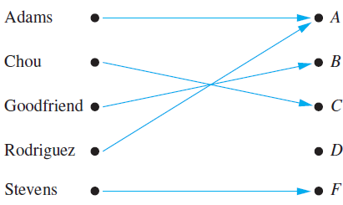
Functions
EXAMPLE 1: What are the domain, codomain, and range of the function
The domain is the set {Adams, Chou, Goodfriend, Rodriguez, Stevens}
The codomain is the set {A, B, C, D, F}.
The range is the set {A, B,C, F}, because each grade except D is assigned to some student.

Slide 8
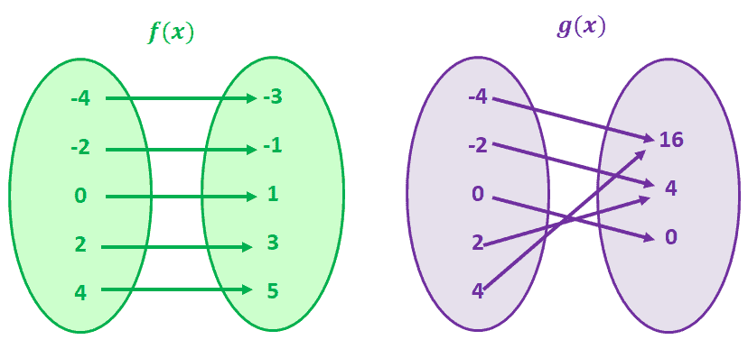

Functions
Definition 5: A function $f$ is said to be one-to-one, or an injection, if and only if $f (a) = f (b)$implies that $a = b$ for all $a$ and $b$ in the domain of $f$.
one-to-one
Not one-to-one

Slide 9
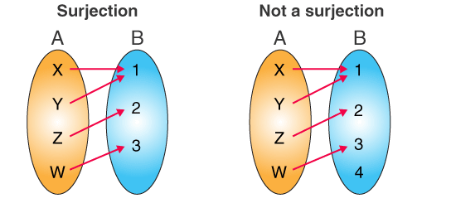

Functions
Definition 7: A function $f$ from $A$ to $B$ is called onto, or a surjection, if and only if for every element $b ∈ B$there is an element $a ∈ A$with $f(a) = b$.

Slide 10
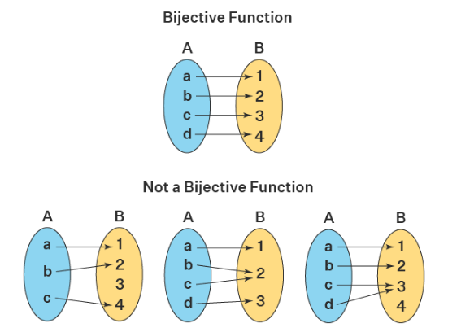

Functions
Definition 8: The function $f$ is a one-to-one correspondence, or a bijection, if it is both one-to-one and onto.

Slide 11
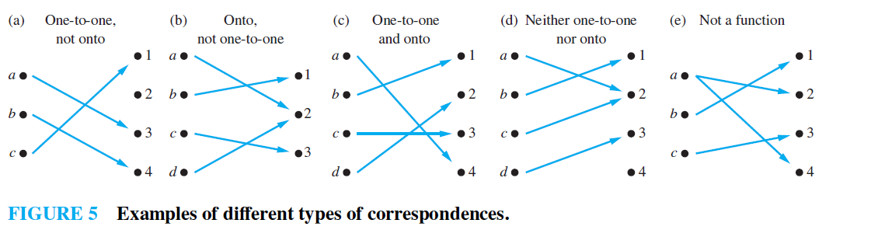
Functions

Slide 12
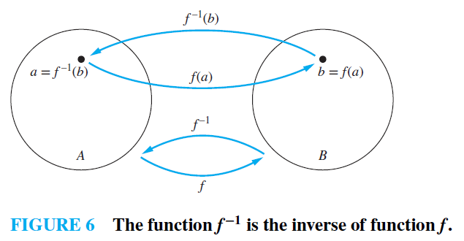

Functions
Definition 9: Inverse function $f^{−1}(b) = a$ when $f(a) = b$.

Slide 13

Functions
EXAMPLE 19: Let $f$ be the function from $\{a, b, c\}$ to $\{1, 2, 3\}$ such that $f(a)=2, f(b)=3$, and $f(c) = 1$. Is $f$ invertible, and if it is, what is its inverse?
Solution: The function $f$ is invertible because it is a one-to-one correspondence. The inverse function $f^{−1}$ reverses the correspondence given by $f$, so $f^{−1}(1) = c$, $f^{−1}(2) = a$, and $f^{−1}(3) = b$.

Slide 14
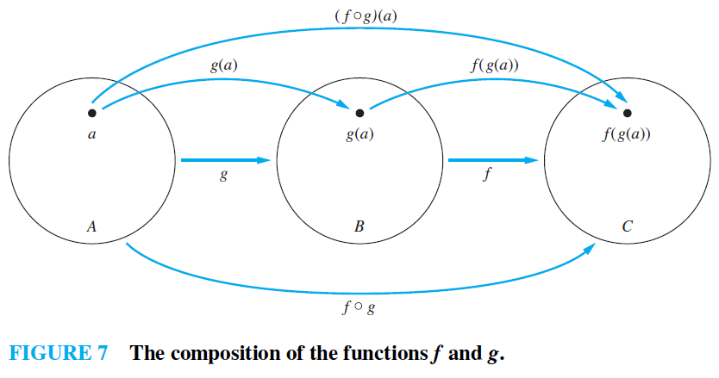

Functions
Definition 10: Let $g$ be a function from the set $A$ to the set $B$ and let $f$ be a function from the set $B$ to the set $C$. The composition of the functions $f$ and $g$, is the function from $A to C$defined by $(f ◦g)(a) = f (g(a)).$

Slide 15

Functions
EXAMPLE 24: Let $f$ and $g$ be the functions from the set of integers to the set of integers defined by $f(x) = 2x + 3$ and $g(x) = 3x + 2$. What is the composition of $f$ and $g$? What is the composition of $g$ and $f$ ?
Solution:
$(f◦g)(x)=f(g(x))=f(3x+2)=2(3x+2)+3=6x + 7$
and
$$(g◦f)(x)=g( f(x))=g(2x+3)=3(2x+3)+2=6x+11.$$

Slide 16

Functions
Definition 12: The floor function ⌊x⌋ assigns to the real number x the largest integer that is less than or equal to x. The ceiling function ⌈x⌉ assigns to the real number x the smallest integer that is greater than or equal to x.
Example 28: $\left\lfloor \frac{1}{2}\right\rfloor =0, \left\lceil \frac{1}{2}\right\rceil =1, \left\lfloor −\frac{1}{2}\right\rfloor =−1, \left\lceil −\frac{1}{2}\right\rceil =0,$ $\left\lfloor 3.1\right\rfloor =3, \left\lceil 3.1\right\rceil =4, \left\lfloor 7\right\rfloor =7, ⌈7⌉ = 7.$

Slide 17
Exercises
4. Find the domain and range of these functions. Note that in each case, to find the domain, determine the set of elements assigned values by the function.
the function that assigns to each nonnegative integer its last digit
c) the function that assigns to a bit string the number of one bits in the string

Slide 18
Exercises
4. Find the domain and range of these functions. Note that in each case, to find the domain, determine the set of elements assigned values by the function.
the function that assigns to each nonnegative integer its last digit
c) the function that assigns to a bit string the number of one bits in the string
The domain is the set of nonnegative integers, and the range is the set of digits (0 to 9).
The domain is the set of all bit strings, and the range is the set of nonnegative integers.

Slide 19

Exercises
8. Find these values.
d) $⌈−0.1⌉$ e) $⌈2.99⌉$ g) $⌊\frac{1}{2} + ⌈\frac{1}{2}⌉ ⌋$

Slide 20
Exercises
8. Find these values.
d) $⌈−0.1⌉$ e) $⌈2.99⌉$ g) $⌊\frac{1}{2} + ⌈\frac{1}{2}⌉ ⌋$
0
3
1

Slide 21

Exercises
10. Determine whether each of these functions from {a, b, c, d} to itself is one-to-one.
a) $f(a)=b, f(b)=a, f(c)=c, f(d)=d$
b) $f(a)=b, f(b)=b, f(c)=d, f(d)=c$

Slide 22

Exercises
10. Determine whether each of these functions from {a, b, c, d} to itself is one-to-one.
a) $f(a)=b, f(b)=a, f(c)=c, f(d)=d$
b) $f(a)=b, f(b)=b, f(c)=d, f(d)=c$
One - to - one
Not one - to - one

Slide 23

Exercises
22. Determine whether each of these functions is a bijection from $R$ to $R$.
b) $f(x)=−3x^{2}+7$
d) $f(x)=x^{5}+1$

Slide 24


Exercises
22. Determine whether each of these functions is a bijection from $R$ to $R$.
b) $f(x)=−3x^{2}+7$
d) $f(x)=x^{5}+1$
To determine that a function is bijection, it must be one-to-one and onto
This is not bijection because it is not one-to-one. Try x = -2 and x = 2.
This is bijection because: it is one-to-one. Try x = -2 and x = 2.
it is onto. Set any value to the expression $x^{5}+1$, you will get a real value for $x$. Try $x^{5}+1=0$, then $x = −1$. Any value for $x=\sqrt[5]{x−1}$

Slide 25
TASK
Section 2.3
4 (b, d)
8 (a, c, f)
10 (c)
22 (a, c)

Slide 26
Content
CH 02
Sets
Set Operations
Functions
Sequences and Summations
Cardinality of Sets
Matrices

Slide 27

Sequences and Summations
Definition 1: A sequence is a function for representing numbers in a certain order.
EXAMPLE 1: Consider the sequence {$a_{n}$}, where $a_{n} =\frac{1}{n}$
The list of the terms of this sequence, beginning with $a_{1}$: $a_{1}, a_{2}, a_{3}, a_{4},…,$
starts with $1,\frac{1}{2},\frac{1}{3},\frac{1}{4},…$

Slide 28
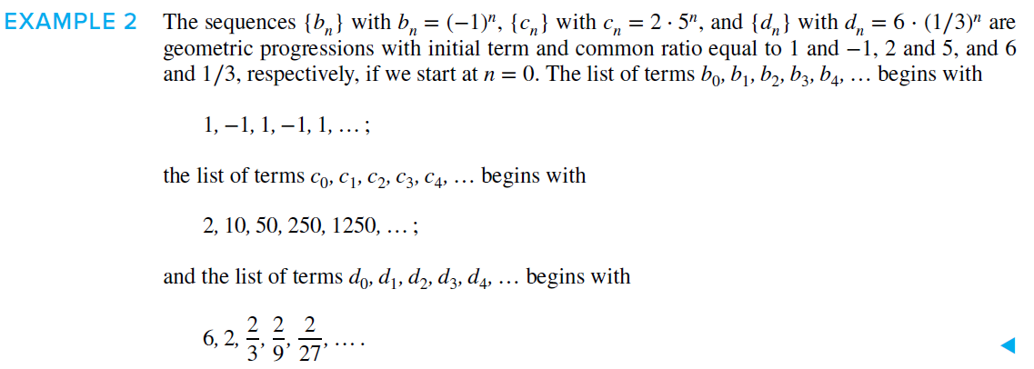

Sequences and Summations
Definition 2: A geometric progression is a sequence of the form $a, ar, ar^{2},…, ar^{n}$
where the initial term $a$ and the common ratio $r$ are real numbers.

Slide 29
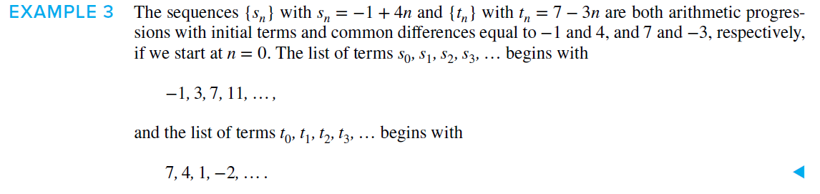

Sequences and Summations
Definition 3: An arithmetic progression is a sequence of the form $a, a+d, a+2d, …, a+nd$
where the initial term $a$ and the common difference $d$ are real numbers.

Slide 30
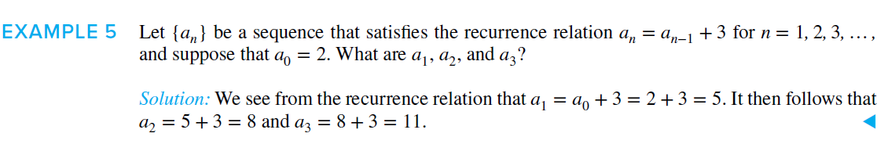
Sequences and Summations
Definition 4: ….

Slide 31

Sequences and Summations
Definition 4: A recurrence relation for the sequence $\{a_{n}\}$ is an equation that expresses an in terms of one or more of the previous terms of the sequence, namely, $a_{0}, a_{1},…, a_{n−1}$, for all integers $n$ with $n ≥ n_{0}$, where $n_{0}$ is a nonnegative integer.

Slide 32
Sequences and Summations
QUIZ: What is Fibonacci series?

Slide 33

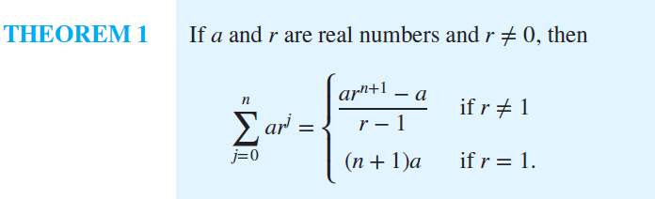
Sequences and Summations
Summation notations
Geometric series

Slide 34

Exercises
1. Find these terms of the sequence $\{a_{n}\}$, where $a_{n}=2⋅{\left(−3\right)}^{n} + 5^{n}$.
a) $a_{0}$ d) $a_{5}$

Slide 35


Exercises
1. Find these terms of the sequence $\{a_{n}\}$, where $a_{n}=2⋅{\left(−3\right)}^{n} + 5^{n}$.
a) $a_{0}$ d) $a_{5}$
$$2 ∗{\left(−3\right)}^{0}+5^{0}=3$$
$$2 ∗{\left(−3\right)}^{5}+5^{5}=2639$$

Slide 36

Exercises
12. Show that the sequence $\{a_{n}\}$is a solution of the recurrence relation $a_{n} = −3a_{n−1} + 4a_{n−2}$if
a) $a_{n}=0$ b) $a_{n}=1$ c) $a_{n} = {\left(−4\right)}^{n}$ d) $a_{n} = 2{\left(−4\right)}^{n} + 3$

Slide 37


Exercises
12. Show that the sequence $\{a_{n}\}$is a solution of the recurrence relation $a_{n} = −3a_{n−1} + 4a_{n−2}$if
a) $a_{n}=0$ b) $a_{n}=1$ c) $a_{n} = {\left(−4\right)}^{n}$ d) $a_{n} = 2{\left(−4\right)}^{n} + 3$
a) $−3∗0+4∗0=0=a_{n}$
b) $−3∗1+4∗1=−3+4=1=a_{n}$
c) $−3∗{\left(−4\right)}^{n−1}+4∗{\left(−4\right)}^{n−2}$ $=−3∗\left(−4\right){\left(−4\right)}^{n−2}+4∗{\left(−4\right)}^{n−2}$
$=12∗{\left(−4\right)}^{n−2}+4∗{\left(−4\right)}^{n−2}$ $=16 ∗{\left(−4\right)}^{n−2}$ $={\left(−4\right)}^{2}∗{\left(−4\right)}^{n−2}={\left(−4\right)}^{n}=a_{n}$
d) $−3∗\left[2{\left(−4\right)}^{n−1}+3\right]+4\left[2∗{\left(−4\right)}^{n−2}+3\right]$
$=−6{∗\left(−4\right)}^{n−1}−9+8∗{\left(−4\right)}^{n−2}+12$ $=−6∗\left(−4\right){\left(−4\right)}^{n−2}−9+8∗{\left(−4\right)}^{n−2}+12$ $=24∗{\left(−4\right)}^{n−2}+8∗{\left(−4\right)}^{n−2}+3$ $=32∗{\left(−4\right)}^{n−2}+3$ $=2∗{\left(−4\right)}^{2}{\left(−4\right)}^{n−2}+3=2∗{\left(−4\right)}^{n}+3$

Slide 38

Exercises
29. What are the values of these sums?
a) $\sum_{k=1}^{5}{\left(k+1\right)}$
d) $\sum_{j=0}^{8}{(2^{j+1}−2^{j})}$

Slide 39
Exercises
29. What are the values of these sums?
a) $\sum_{k=1}^{5}{\left(k+1\right)}$
d) $\sum_{j=0}^{8}{(2^{j+1}−2^{j})}$
(1+1) + (2+1) + (3+1) + (4+1) + (5+1) = 20
$$\left(2^{0+1}−2^{0}\right)+\left(2^{1+1}−2^{1}\right)+\left(2^{2+1}−2^{2}\right)+\left(2^{3+1}−2^{3}\right)+\left(2^{4+1}−2^{4}\right)+\left(2^{5+1}−2^{5}\right)+\left(2^{6+1}−2^{6}\right)+\left(2^{7+1}−2^{7}\right)+\left(2^{8+1}−2^{8}\right)=511$$

Slide 40

Exercises
31. What is the value of each of these sums of terms of a geometric progression?
b) $\sum_{j=1}^{8}{2^{j}}$
c)$\sum_{j=0}^{8}{2∗(−{3)}^{j}}$

Slide 41
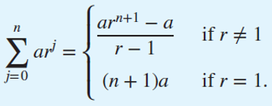
Exercises
31. What is the value of each of these sums of terms of a geometric progression?
b) $\sum_{j=1}^{8}{2^{j}}$
c)$\sum_{j=0}^{8}{2∗(−{3)}^{j}}$
$$2^{1}+2^{2}+2^{3}+2^{4}+2^{5}+2^{6}+2^{7}+2^{8}=510$$
$$\frac{2∗{\left(−3\right)}^{8+1} −2}{−3−1}=9842$$

Slide 42

Exercises
33. Compute each of these double sums.
a) $\sum_{i=1}^{2}{\sum_{j=1}^{3}{(i+j)}}$ c) $\sum_{i=1}^{3}{\sum_{j=0}^{2}{i}}$

Slide 43


Exercises
33. Compute each of these double sums.
a) $\sum_{i=1}^{2}{\sum_{j=1}^{3}{(i+j)}}$ c) $\sum_{i=1}^{3}{\sum_{j=0}^{2}{i}}$
$$i=1:$$ $j=1, 2, 3$ → (1+1) + (1+2) + (1+3)
$$i=2:$$ $j=1, 2, 3$ → (2+1) + (2+2) + (2+3)
21
$$i=1:$$ $j=0 , 1, 2$ → (1) + (1) + (1)
$$i=2:$$ $j=0 , 1, 2$ → (2) + (2) + (2)
$$i=3:$$ $j=0 , 1, 2$ → (3) + (3) + (3)
18

Slide 44
TASK
Section 2.4
1 (b, c)
29 (b, c)
31 (a, c)
33 (b, d)

Slide 45
Content
CH 02
Sets
Set Operations
Functions
Sequences and Summations
Cardinality of Sets
Matrices

Slide 46
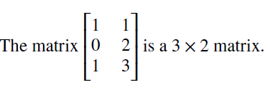
Matrices
EXAMPLE 1: matrix definition

Slide 47
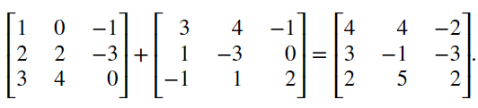
Matrices
EXAMPLE 2: matrix addition
Matrices of different sizes cannot be added, because such matrices will not both have entries in some of their positions.

Slide 48
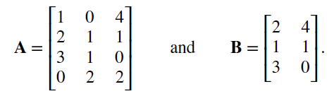
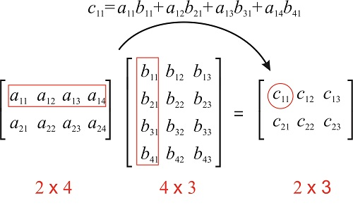
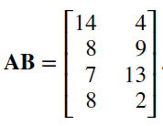
Matrices
EXAMPLE 4: matrix multiplication
The number of elements in a row must be equal to the number of elements in a column

Slide 49
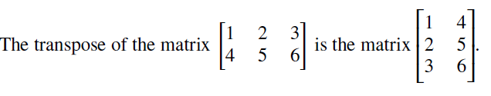
Matrices
EXAMPLE 5: transpose matrix

Slide 50
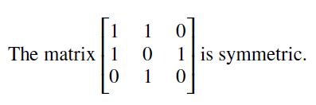
Matrices
EXAMPLE 6: symmetric matrix
The transpose of a square matrix is the same as the original matrix

Slide 51
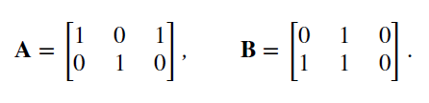
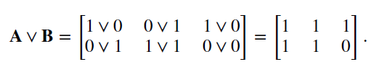


Matrices
EXAMPLE 7: Zero-one matrix
The join operation is $∨$
The meet operation is $∧$

Slide 52
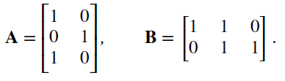
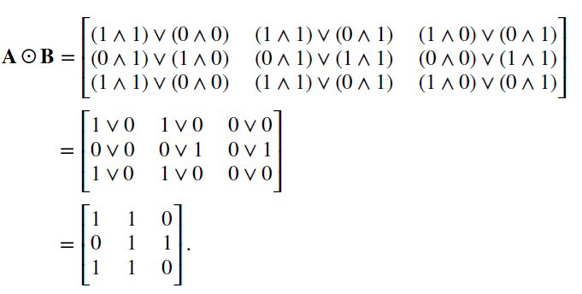
Matrices
EXAMPLE 8: Boolean product

Slide 53
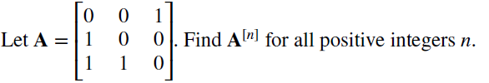
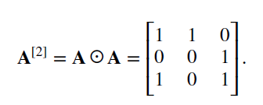
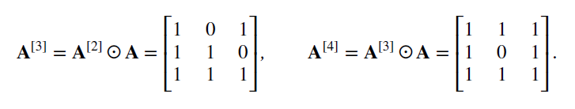
Matrices
EXAMPLE 9: rth Boolean power

Slide 54


Exercises
1. Let $A =$
a) What size is A?
b) What is the third column of A?
c) What is the second row of A?
d) What is the element of A in the (3, 2)th position?
e) What is $A^{t}$?

Slide 55


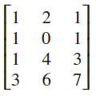
Exercises
1. Let $A =$
a) What size is A?
b) What is the third column of A?
c) What is the second row of A?
d) What is the element of A in the (3, 2)th position?
e) What is $A^{t}$?
3 X 4
1

Slide 56

Exercises
2. Find A + B, where

Slide 57

Exercises
2. Find A + B, where

Slide 58


Exercises
3. Find AB if

Slide 59

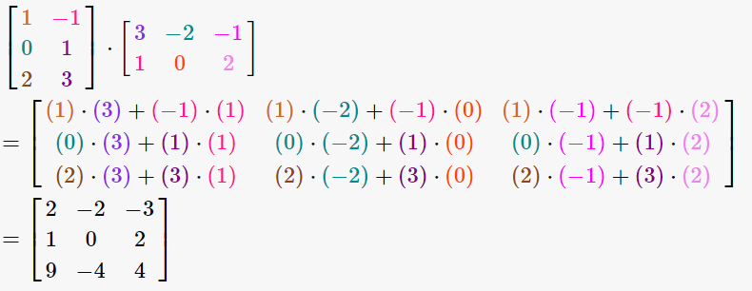
Exercises
3. Find AB if

Slide 60
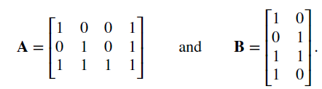
Exercises
28. Find the Boolean product of A and B, where

Slide 61

Exercises
28. Find the Boolean product of A and B, where

Slide 62
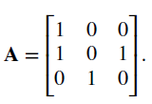

Exercises
29. Let
a) Find $A^{\left[2\right]}$

Slide 63

Exercises
29. Let
a) Find $A^{\left[2\right]}$

Slide 64
TASK
Section 2.6
2 (b)
3 (c)
29 (b)

